Slide 1


Topic 1
Power electronic equipment in our daily life
Zhang Jiaquan
Wang Xingyi
Li Fangchao
Presenters:

Slide 2
1.The division of work
2. Introduction
Contents
3. Major sections of the device
4. Parameters

Slide 3
01
The division of work

Slide 4
The division of work
Xingyi Wang introduces the background knowledge, working principle and input/output characteristics of induction cooker.
Fangchao Li will introduce the circuit topology and function of induction cooker, and divide the modules of driving circuit, control circuit and high voltage protection circuit.
Jiaquan Zhang introduces the three parameters of surge current, breakdown voltage and maximum power dissipation.

Slide 5
01
Introduction

Slide 6
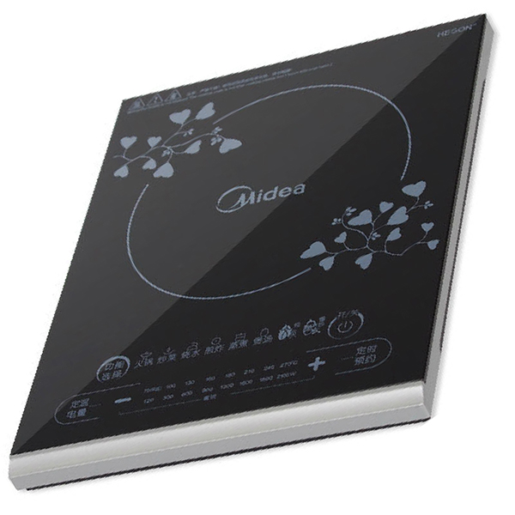
The Induction Cooker produced by Midea
Induction Cooker is a type of electric cooking that uses magnetic coils to heat cookware. The induction cooking craze has been getting lots of buzz even though the technology has been around for about a century.
The beauty of induction cooking ：
“No Cookware, No Energy wastage.” There will be no heat generated without the cookware on the top of the coil. Thus, the induction cooker is quicker and highly energy efficient.
What is more, you can conveniently adjust the size of power based on different modes given by the cooker instructions.
Besides, it is safer because the open flame can be avoided during cooking.
Midea C21-ST2106

Slide 7
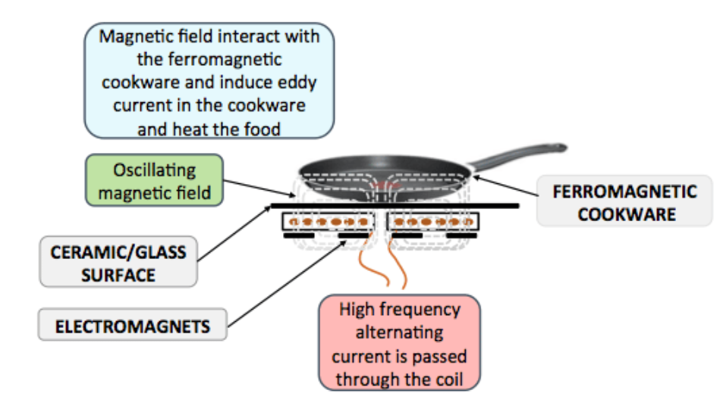
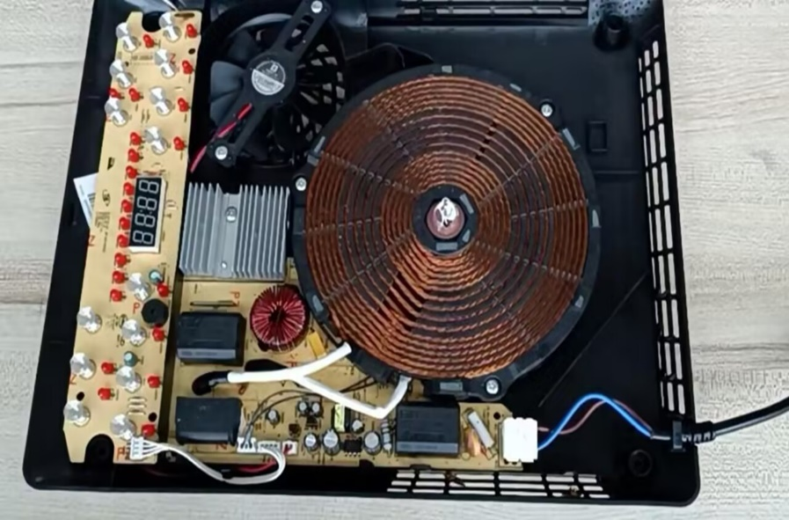
Working principle of the Induction Cooker
Dismantling diagram
The working principle diagram of the induction cooker

Slide 8
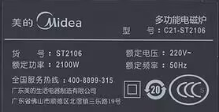
Input and Output Features
Rated Voltage: 220V
Rated Frequency: 50Hz
Rated Maximum Power: 2100W
The label of Midea C21-ST2106

Slide 9
03
Major sections of the device

Slide 10
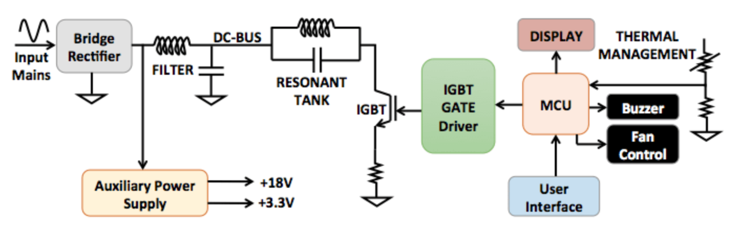
Simplified schematic diagram analysis
Simplified schematic diagram of the circuit

Slide 11
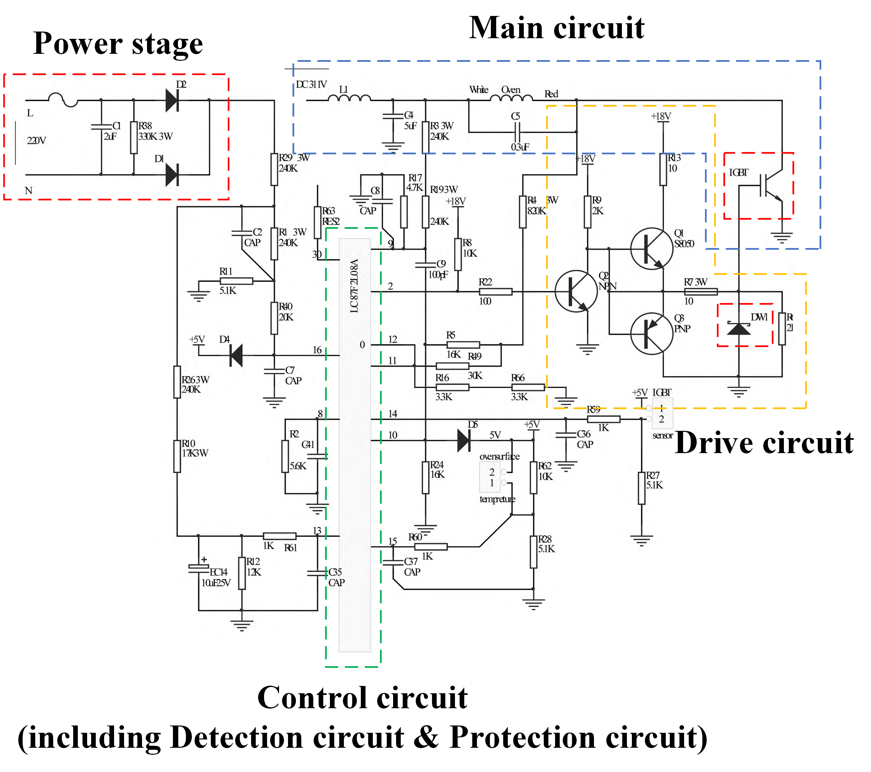
Main function circuit diagram analysis
Control circuits
(LC87F2L08A as the core)
Gate control VC voltage detection Surge voltage detection circuit, Pot bottom temperature detection circuit, Gate control temperature detection circuit, Over voltage and over current detection circuit, PWM pulse circuit and other intelligent control functions.

Slide 12
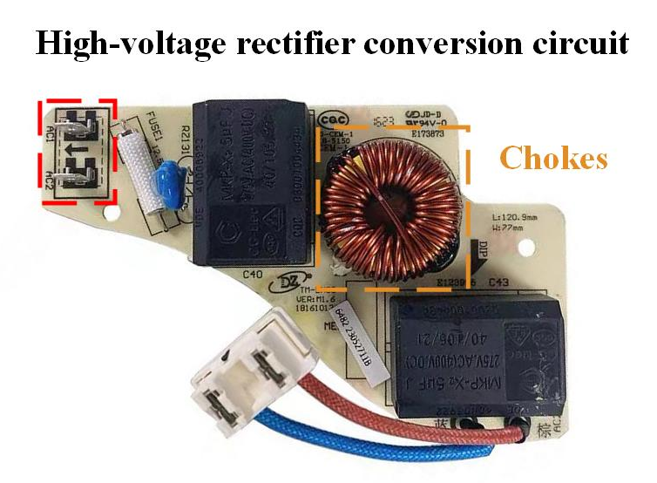
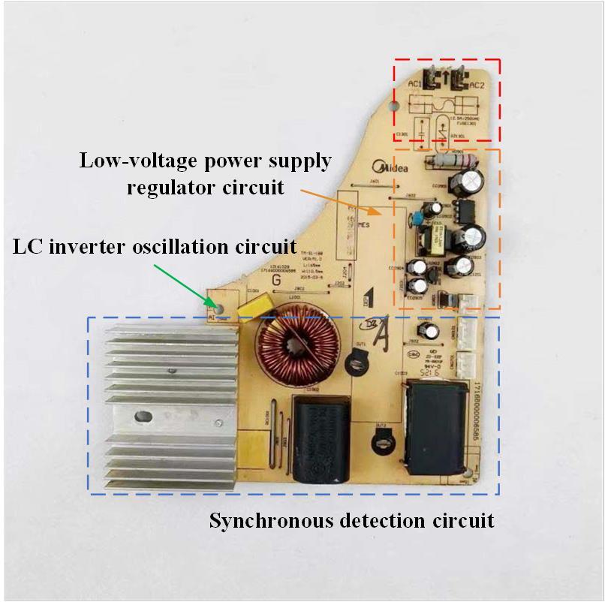
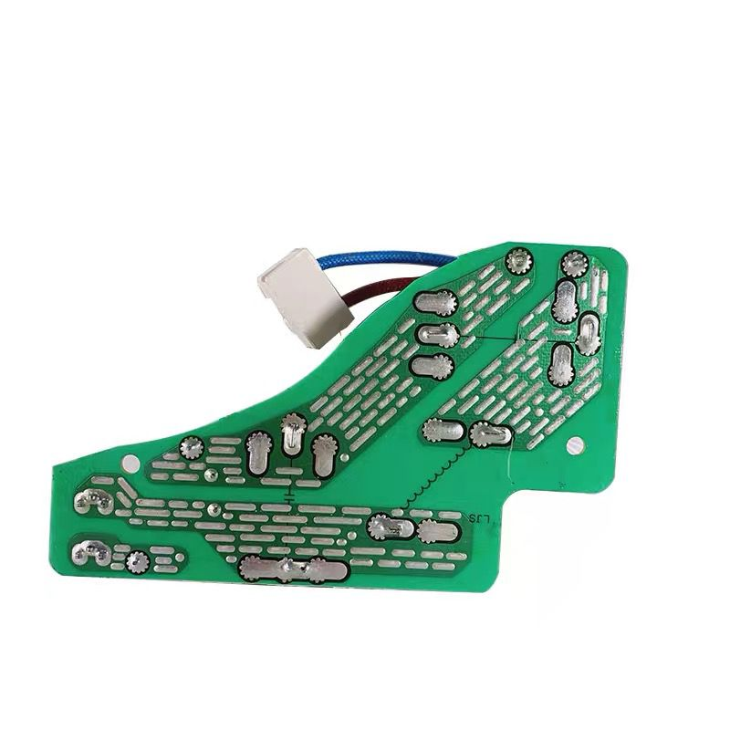
Physical drawing analysis
Front and back views of Circuit Board 1
Front view of Circuit Board 2

Slide 13
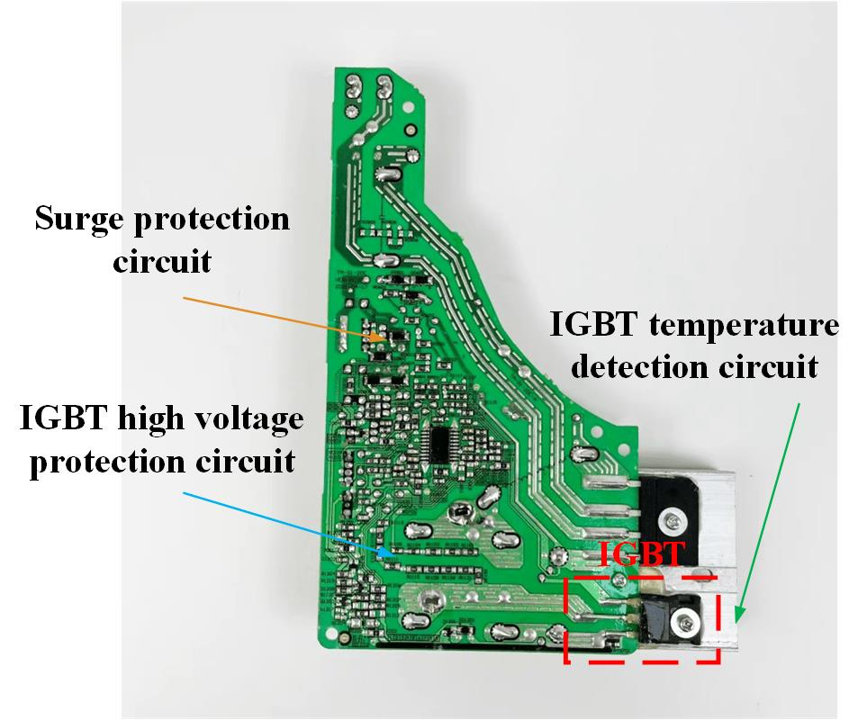
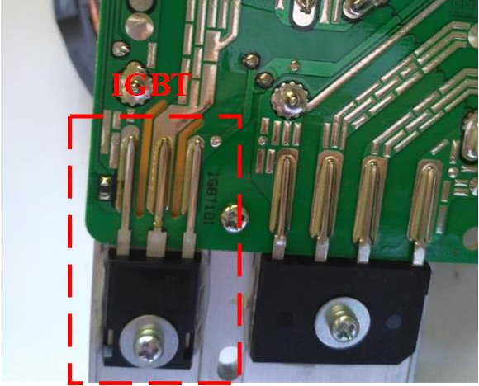
Physical drawing analysis
The location of the IGBT
Front view of Circuit Board 2

Slide 14
04
Parameters

Slide 15
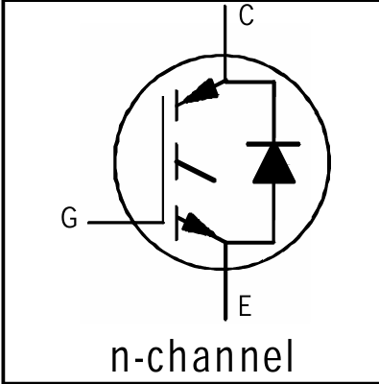
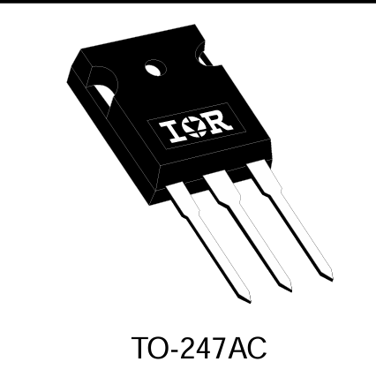
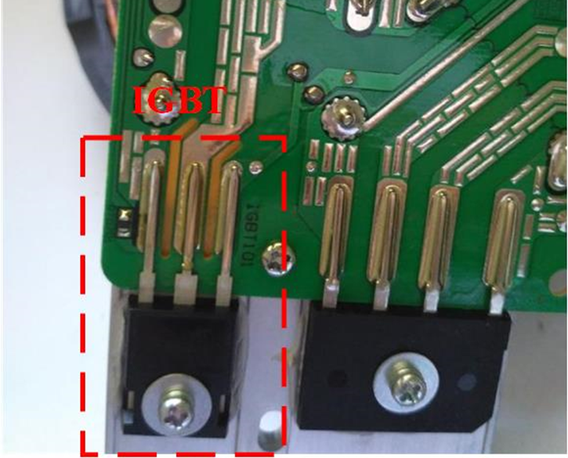
The model of IGBT from datasheet
IGBT from actual circuits

Slide 16
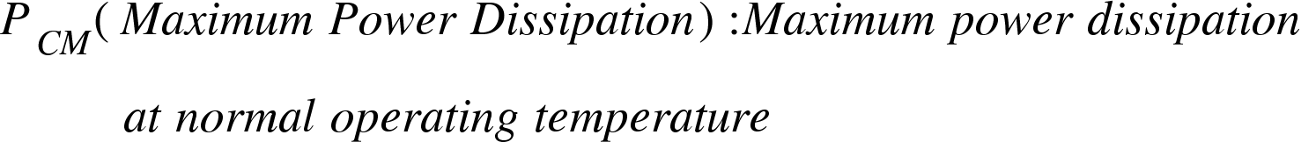

Slide 17
Thank you!

Slide 18
Topic 2
Comparison between simulation and characteristics given by datasheet
Zhang Jiaquan
Wang Xingyi
Li Fangchao
Presenters:

Slide 19
1. Division of work
Contents
2.Comparison between simulation and datasheet

Slide 20
01
Division of work

Slide 21
The division of work
Zhang Jiaquan introduces the output characteristic curve.
Wang Xingyi introduces the transfer characteristic and forward Forward characteristic of reverse diode curve.
Fangchao Li introduces the switching characteristics of IGBT.

Slide 22
02
Comparison between simulation and datasheet

Slide 23
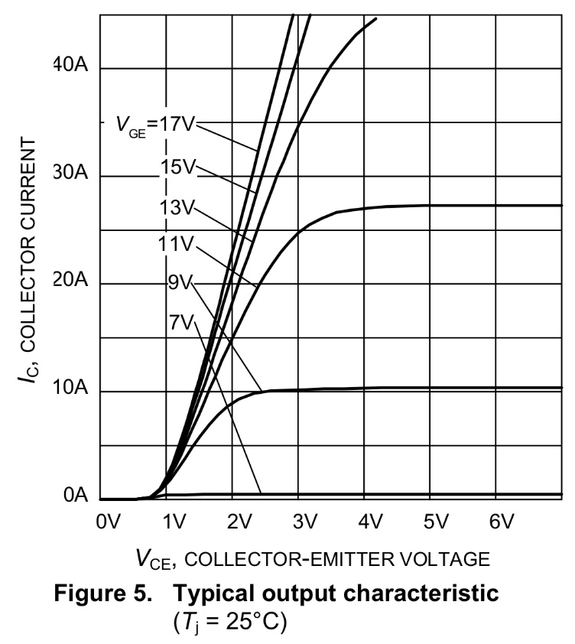
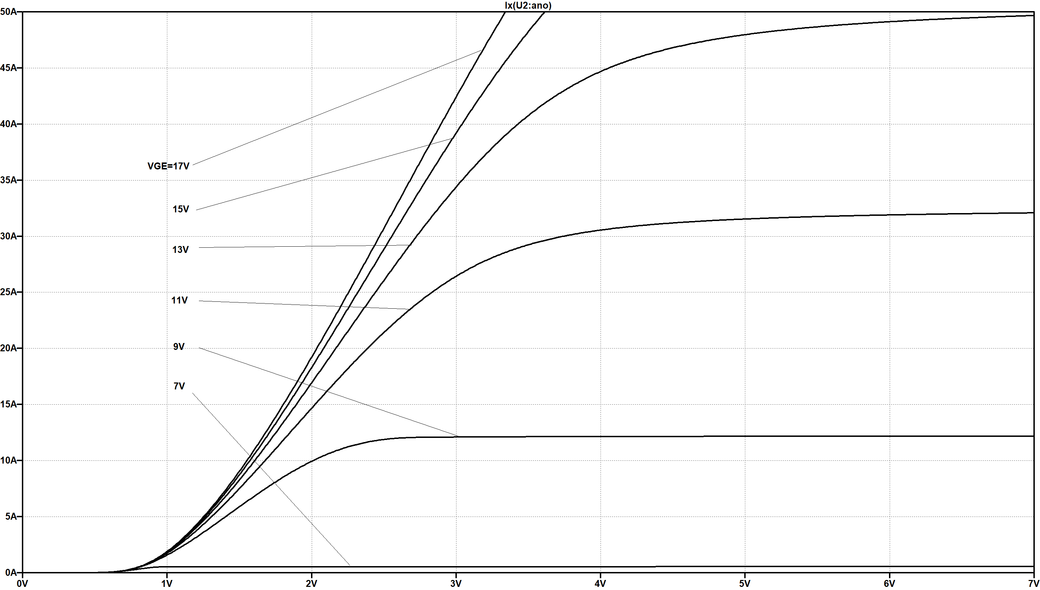
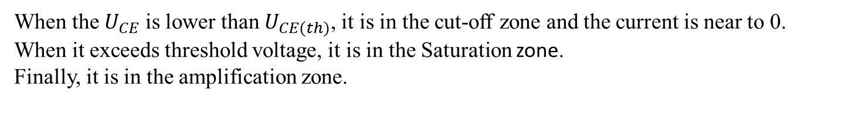
Typical output characteristic
When the $U_{CE}$ is lower than $U_{CE(th)}$, it is in the cut-off zone and the current is near to 0.
When it exceeds threshold voltage, it is in the Saturation zone.
Finally, it is in the amplification zone.

Slide 24
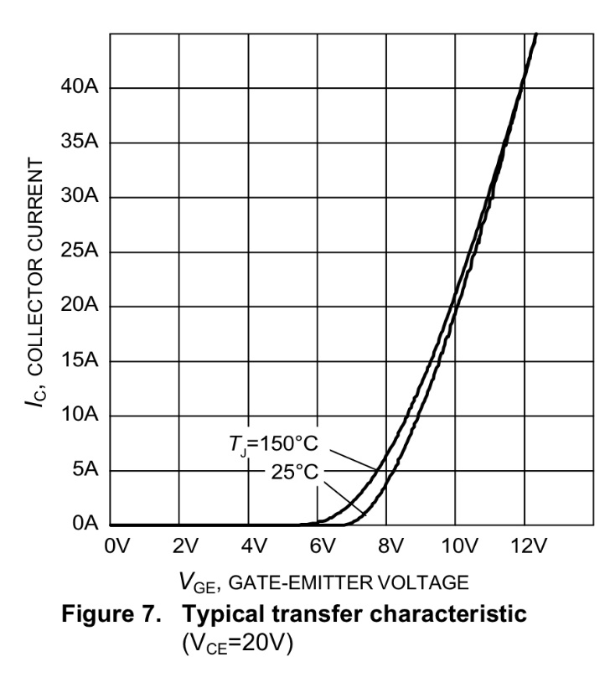
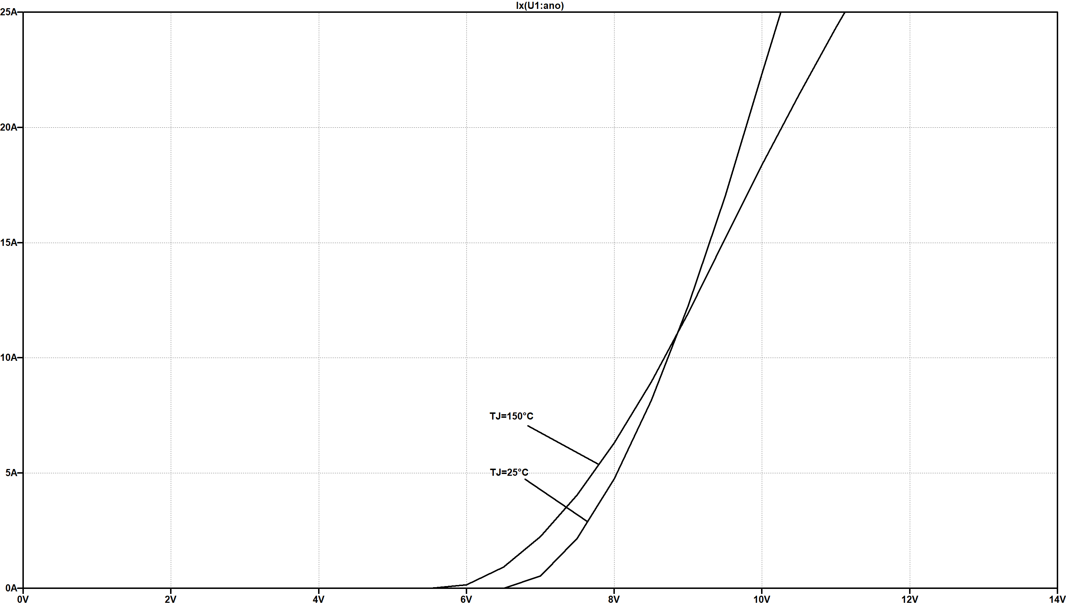
Typical transfer characteristic

Slide 25
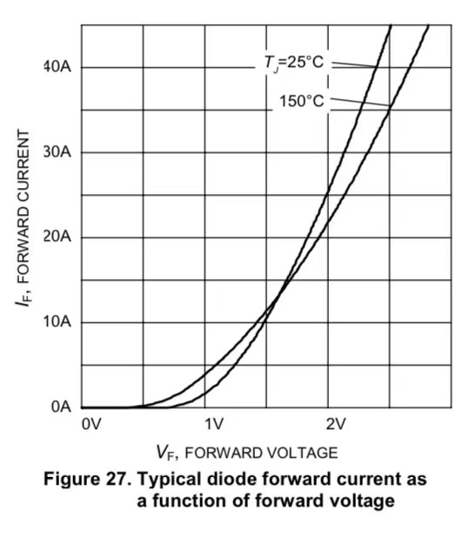
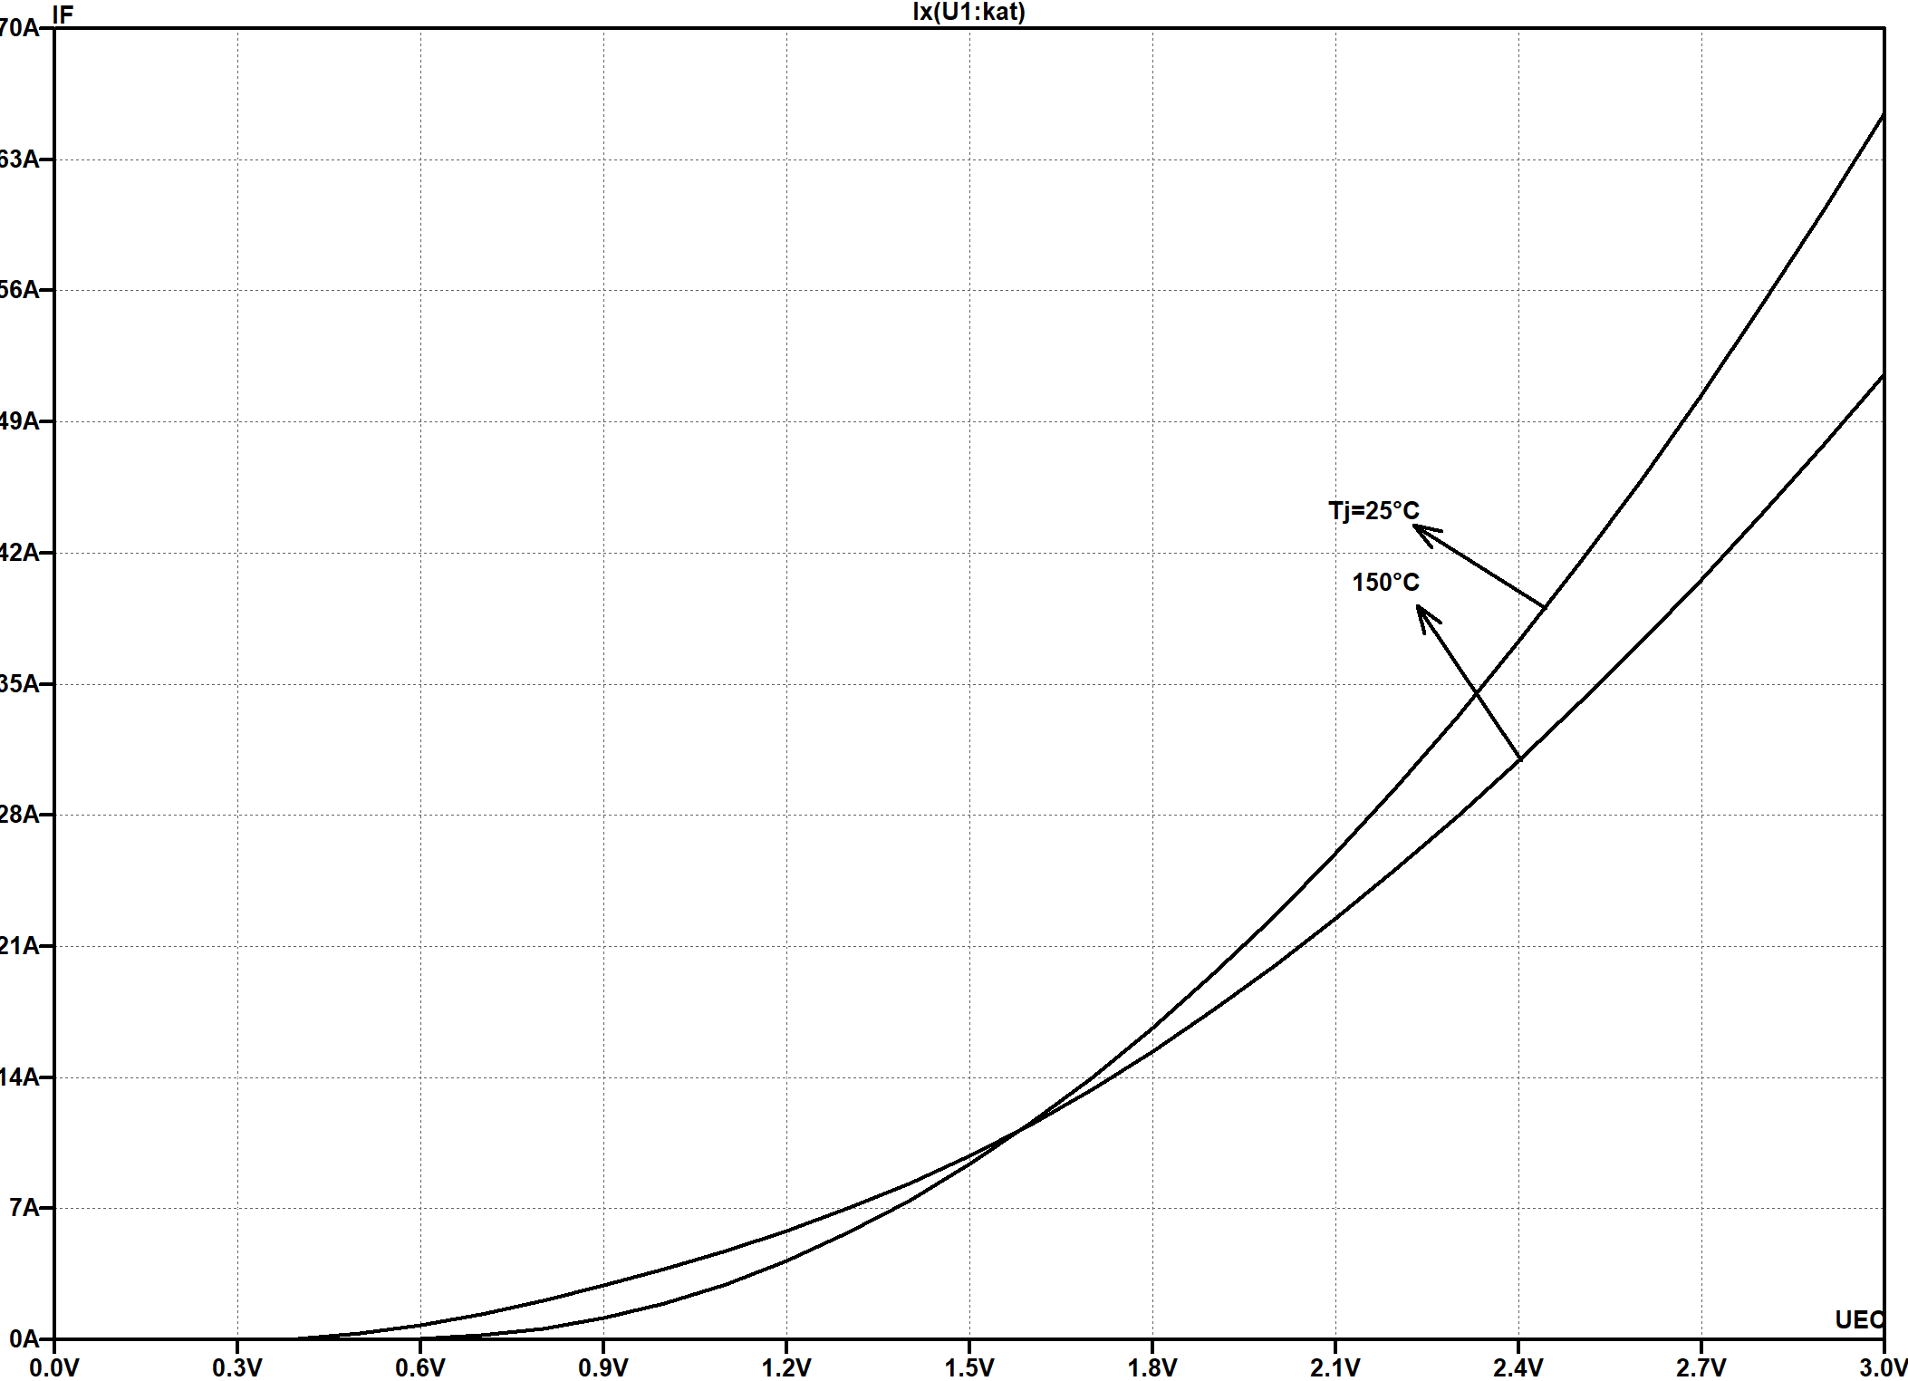
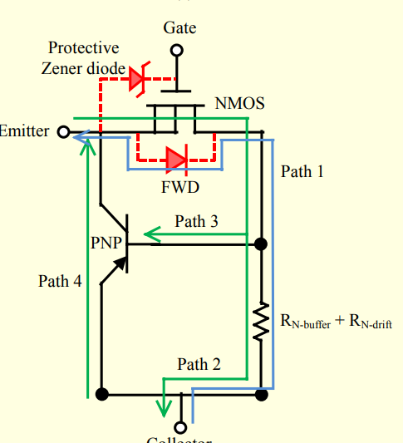
Forward characteristic of reverse diode

Slide 26
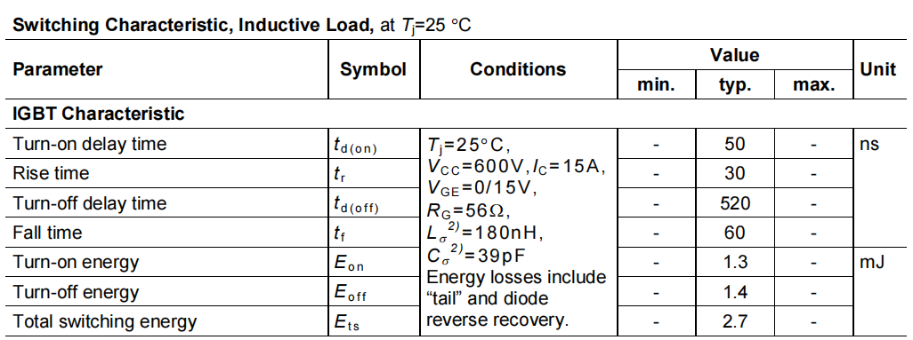
Switching waveform
Switching characteristic of the IKW15T120 at 25℃ (Inductive Load)

Slide 27
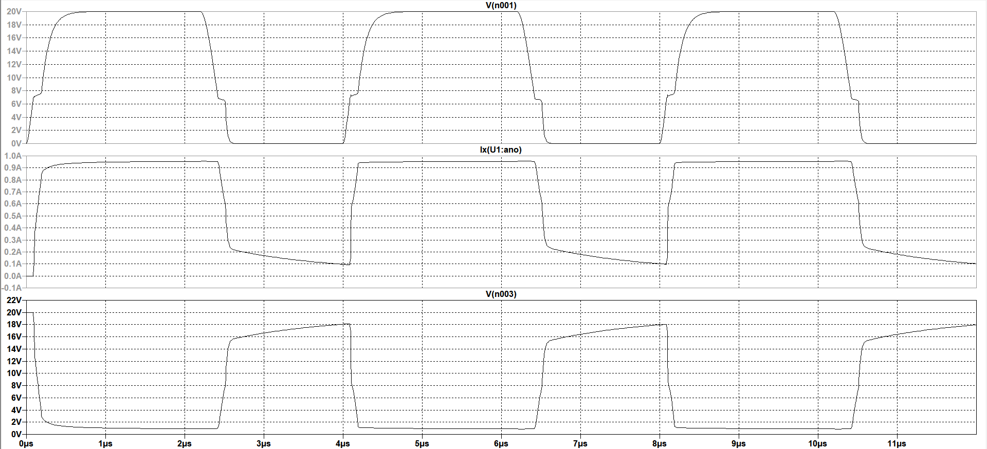
Switching waveform
turn-on process
and
turn-off process
the nanosecond range
Miller Plateau
and
Tailing Current
Switching waveform of the IKW15T120

Slide 28
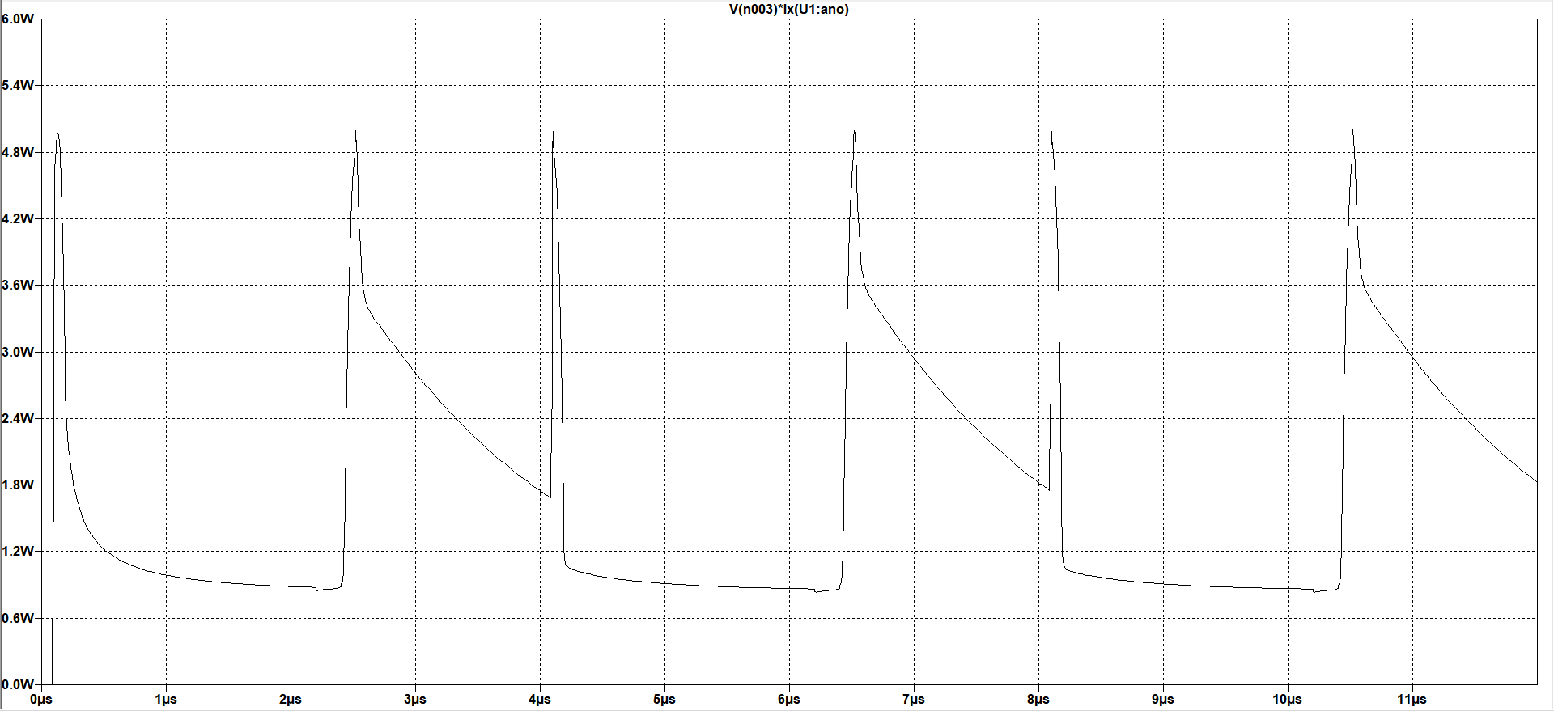
Switching waveform
on-state loss
(conduction loss)
and
off-state loss
switching loss
turn-on loss
and
turn-off loss
the energy losses of the switching process of the IKW15T120
power loss

Slide 29
Thank you!

